Slide 1
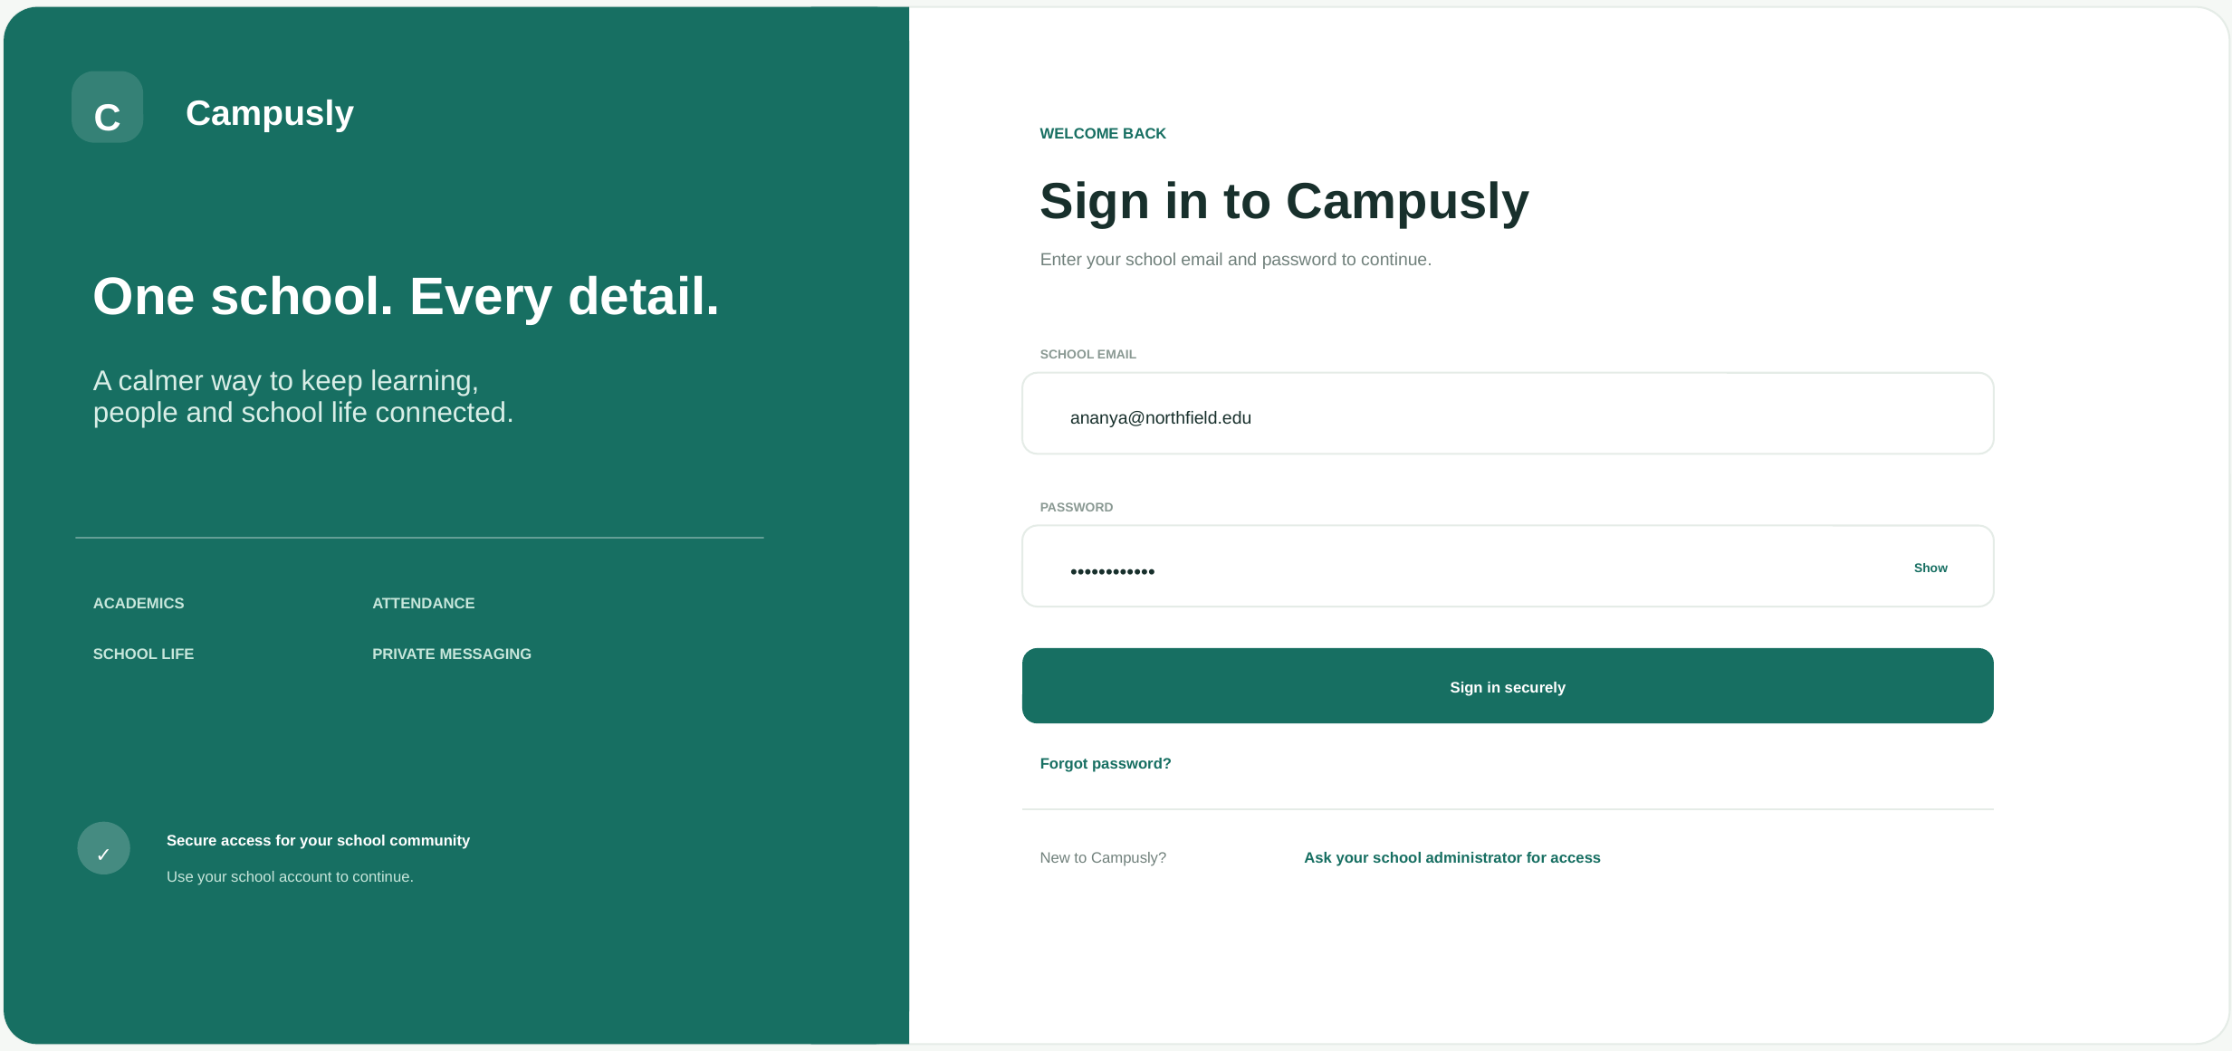
MINI PROJECT
Campusly
School Management System
One school. Every detail.
Secure sign-in for the school community
Submitted by: NIVAS KANNAN R (251701065)
Notes:
Introduce the project: Campusly, a school management system with a unified, privacy-first workspace.

Slide 2
ABSTRACT
Campusly is a school management platform that brings learning, people and school life into one calm, secure workspace.
School staff sign in with their school account and manage attendance, academics, fees, transport, library and campus activities, and private messaging from a single dashboard.
Role-aware access and a privacy-first directory keep personal phone numbers and email addresses hidden, so families and staff communicate safely inside the school space.
9
Integrated modules
1
Unified school workspace
100%
Private, role-aware access
Notes:
Summarise what Campusly does and why it matters.

Slide 3
EXISTING SYSTEM
How many schools manage day-to-day operations today, and where it falls short.
Scattered tools
Manual paperwork
Poor communication
Attendance, fees, transport and messaging live in separate registers, spreadsheets and apps.
Roll calls and fee records are entered by hand, which is slow and prone to errors.
Notices and parent updates go through personal calls and chat groups with no official record.
Privacy risks
Limited visibility
Hard to follow up
Sharing personal phone numbers and emails exposes staff and families.
Leaders cannot see attendance, collections and requests in one daily view.
Pending leave requests, fee reminders and route changes are easily missed.
Notes:
Describe the pain points of the current approach. Edit to match your own research.

Slide 4
PROPOSED SYSTEM
One secure sign-in opens a role-aware workspace with nine connected modules.
01
Login & access
02
Overview
03
Attendance
Private school-account sign-in
Daily snapshot of the whole school
Class roll, late arrivals, leave requests
04
Academics
05
People
06
Fees & payments
Classes, assignments, progress
Verified directory, contacts hidden
Collections and private reminders
07
Transport
08
Library & campus
09
Messages & privacy
Routes, buses and live status
Loans, spaces and activities
Private inbox and profile controls
Notes:
Walk through the modules from login to profile & privacy.

Slide 5
ADVANTAGES OF OUR APPLICATION
01
Everything in one place
02
Privacy by design
Academics, attendance, fees, transport, library and messages share one workspace.
Phone numbers and personal emails stay hidden; contact happens through verified school profiles.
03
Time saved daily
04
Clear, calm interface
Quick attendance, instant summaries and clear follow-up lists reduce manual effort.
A clean layout with simple navigation that staff learn quickly.
05
Better family connection
06
Informed decisions
Class groups and private conversations keep parents informed and engaged.
Live figures on attendance, collections and requests support leaders every day.
Notes:
Highlight the benefits for staff, families and school leaders.

Slide 6
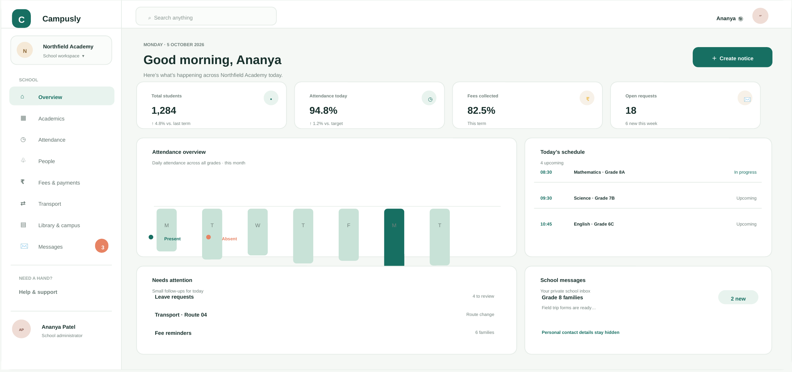
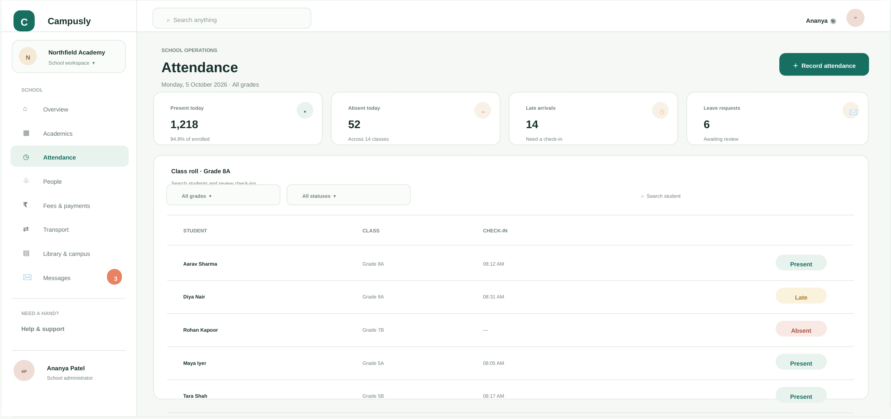
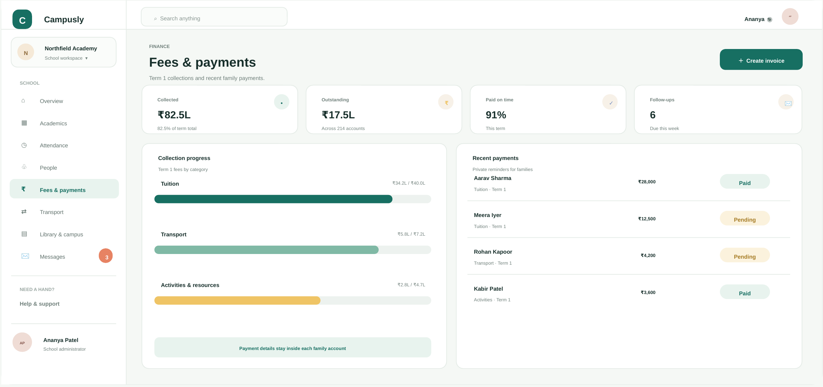
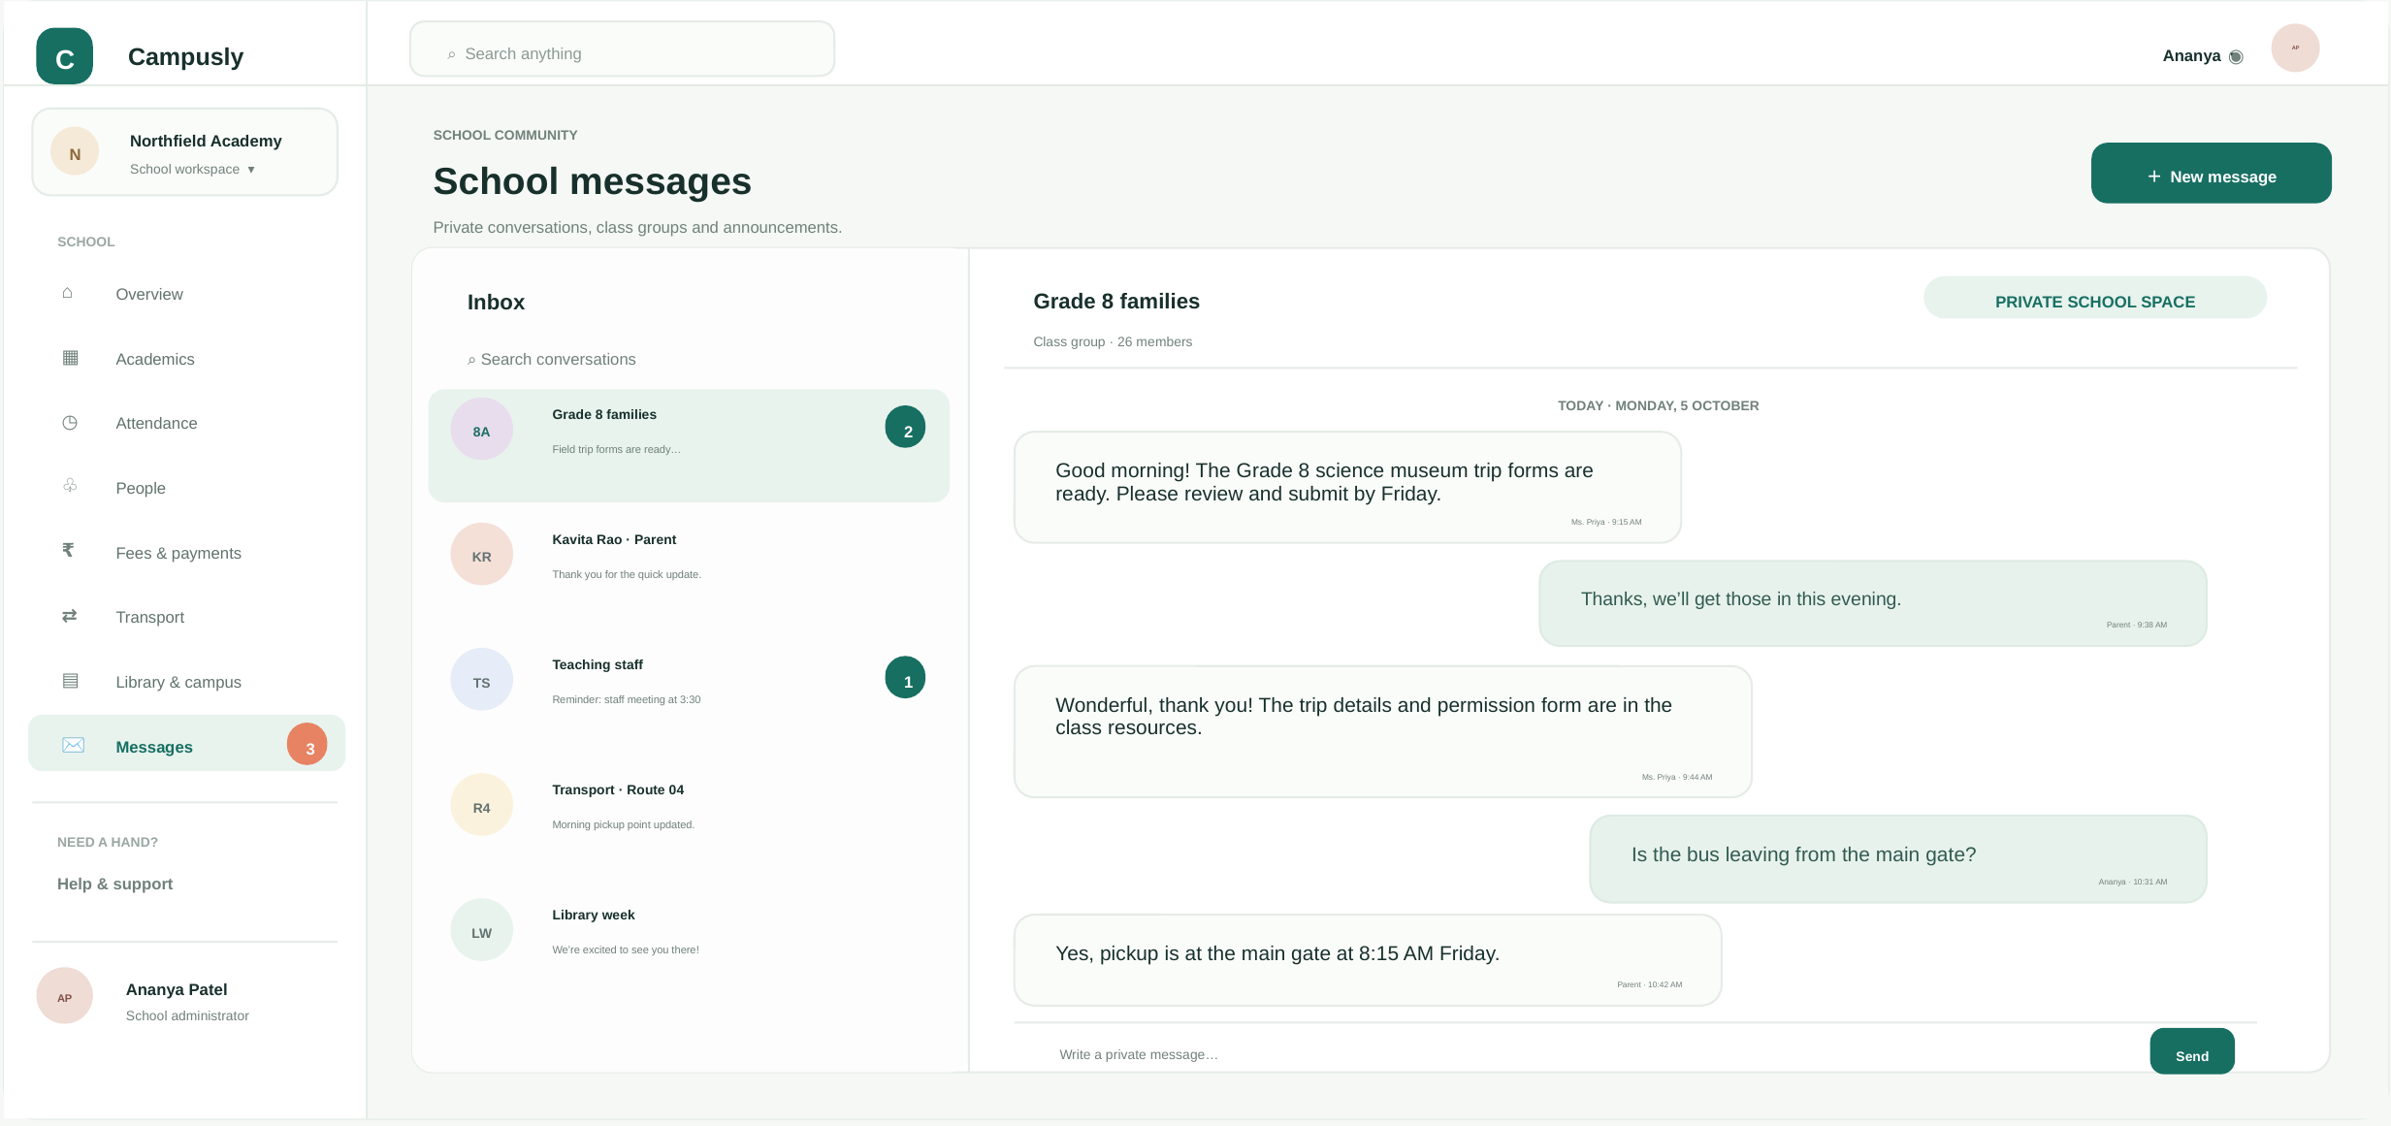
APPLICATION SCREENSHOTS
1. School overview dashboard
2. Attendance management
3. Fees & payments tracking
4. Private school messaging
Notes:
Show each screen: overview, attendance, fees and messages.

Slide 7
THANK YOU
Campusly · One school. Every detail.
Questions?

